Slide 1
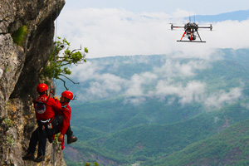
Search and
Rescue drone
Ilona BERTIN, Mélina BRUTIER, Louis OSCABY, Florent NASSCHAERT

Slide 2
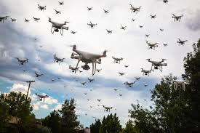
Problem Statement
How to design a drone swarm capable of effectively locating, detecting, and alerting to the presence of a person in distress?

Slide 3
Table of contents
01
02
03
04
Human
Search
Drone conception
Thermal
Analysis
Image
Processing

Slide 4
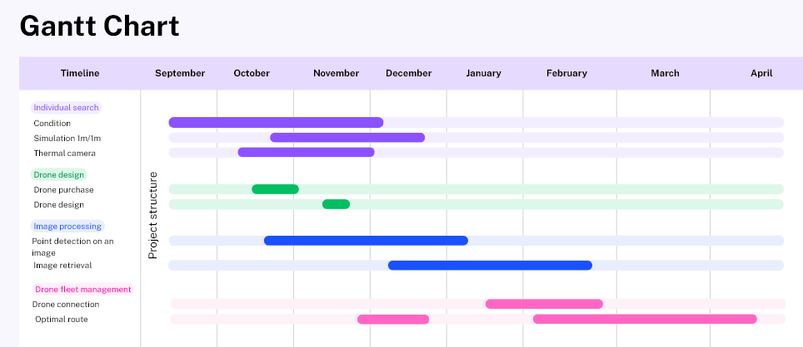

Slide 5
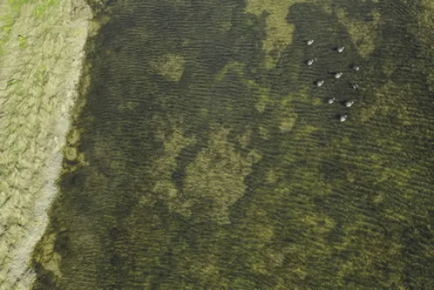
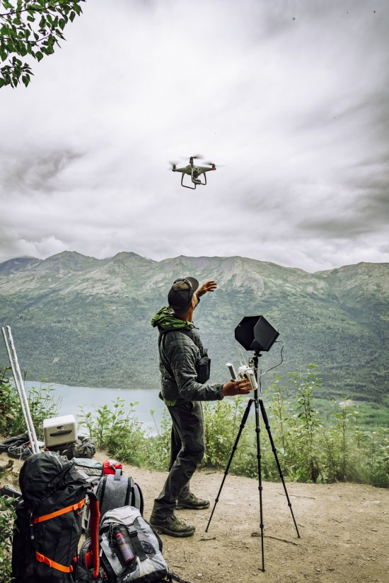
01
Human
Search

Slide 6
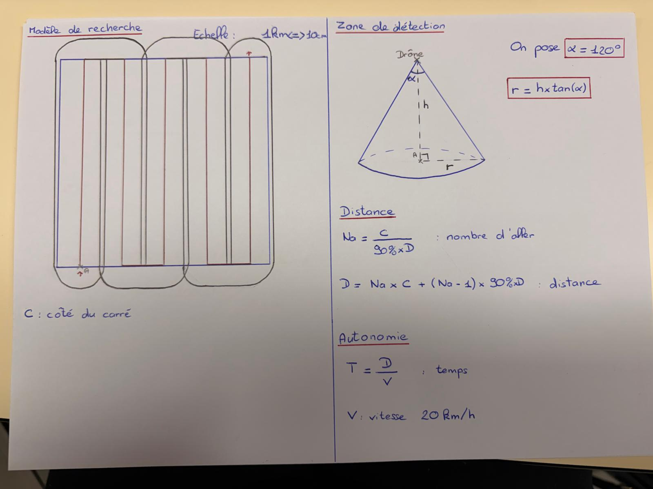
Search for individuals on a flat 1 km² plot

Slide 7
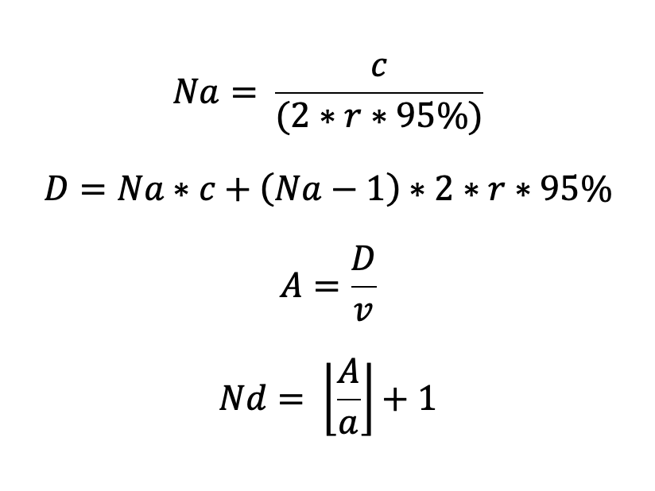
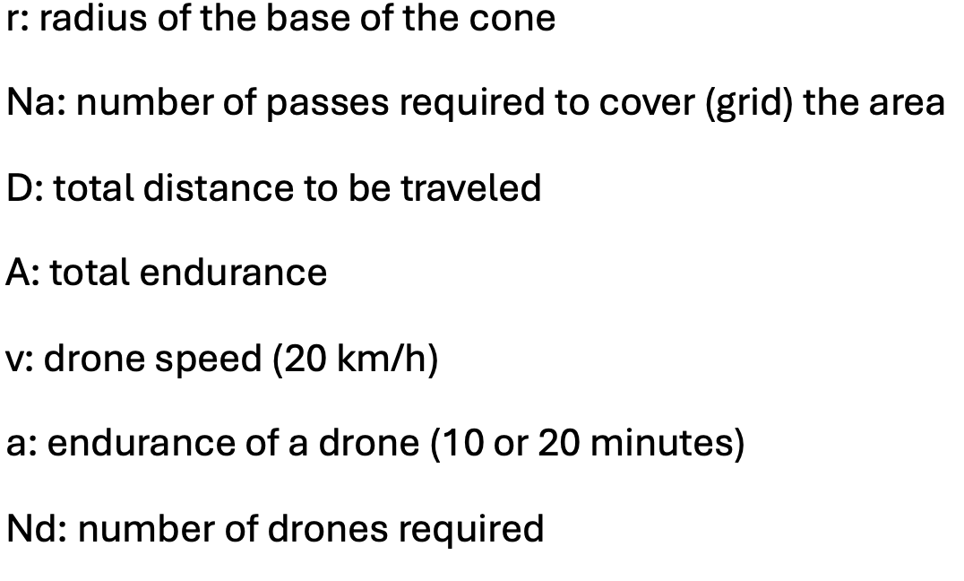
Search for individuals on a flat 1 km² plot

Slide 8
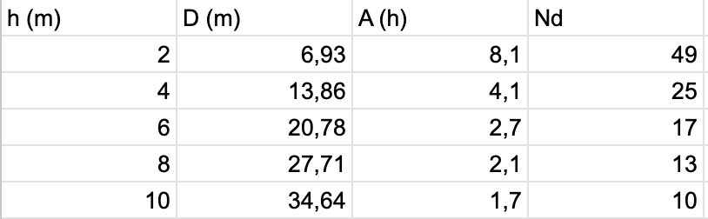
Search for individuals on a flat 1 km² plot
a = 10 min

Slide 9
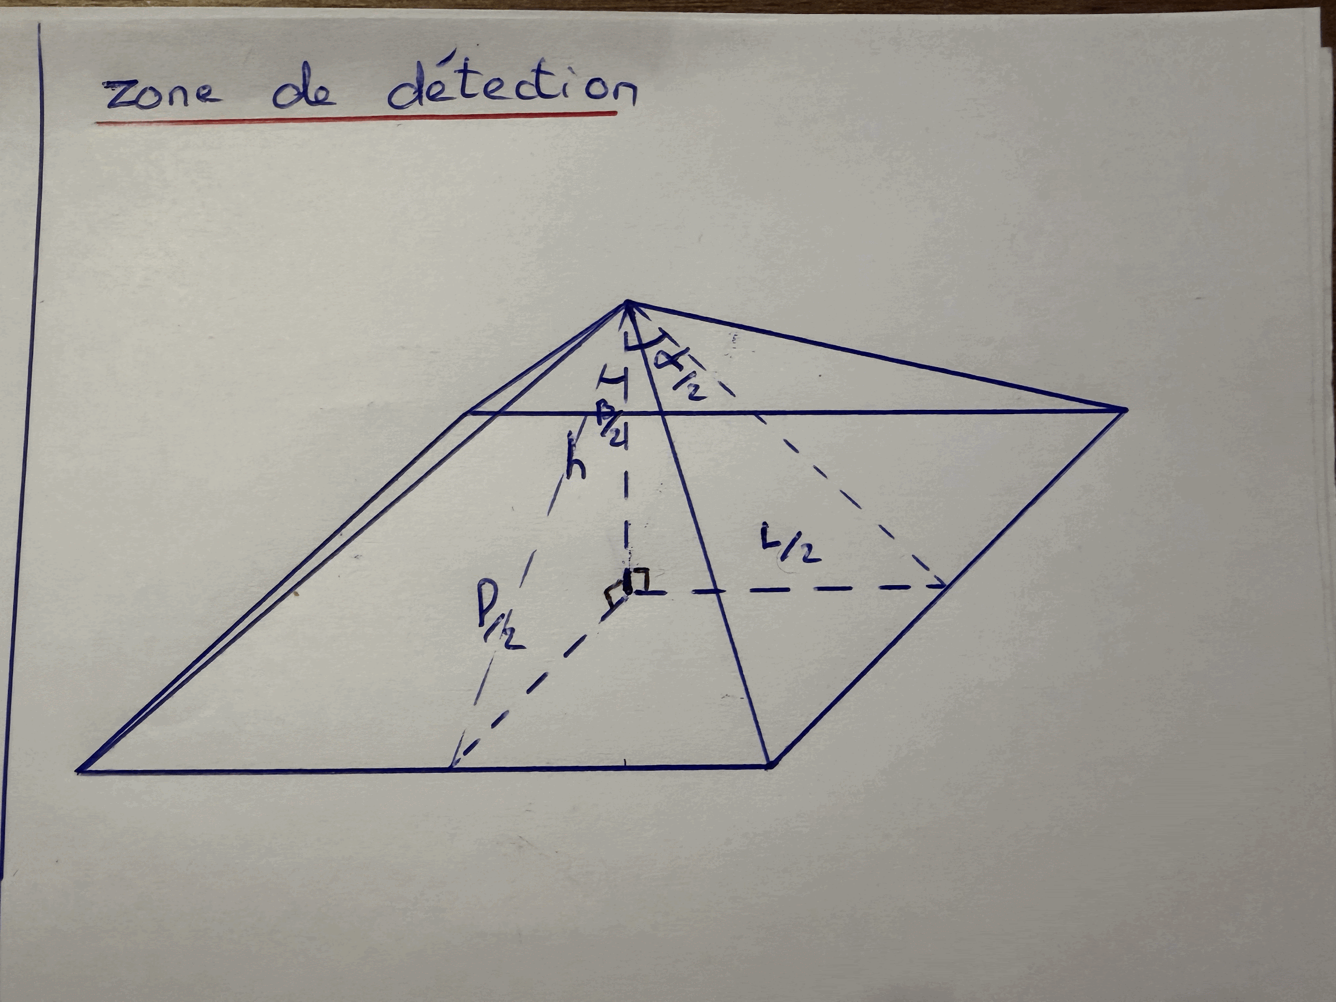
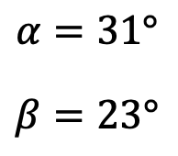
Search for individuals on a flat 1 km² plot
Angle carré à changer

Slide 10
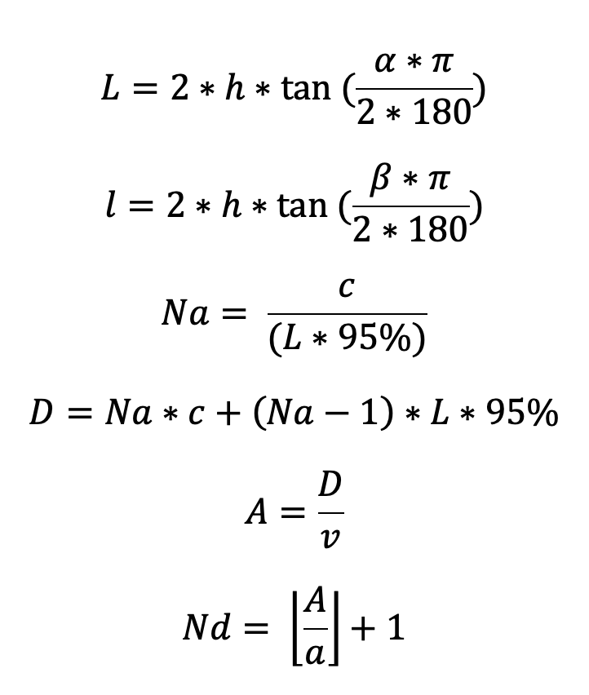
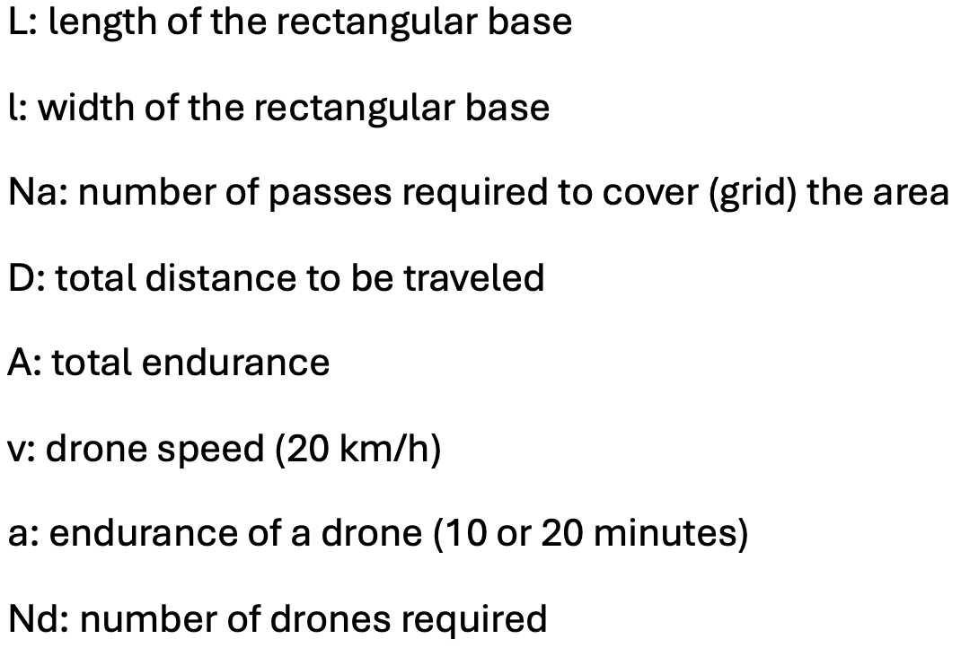
Search for individuals on a flat 1 km² plot

Slide 11
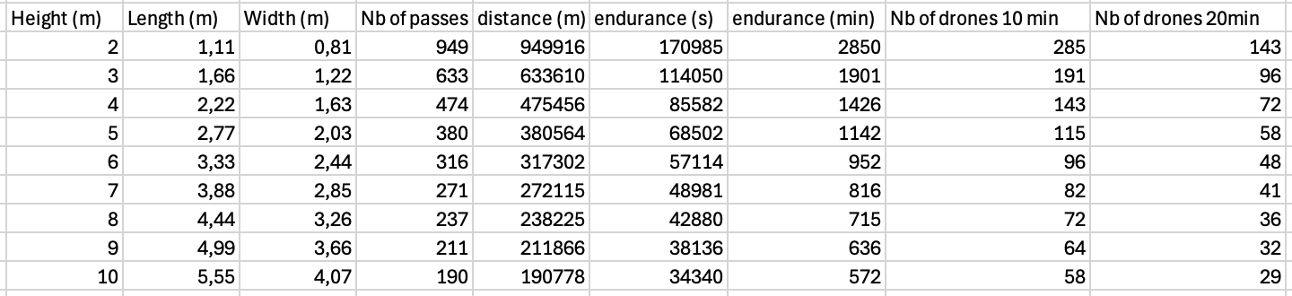
Search for individuals on a flat 1 km² plot

Slide 12
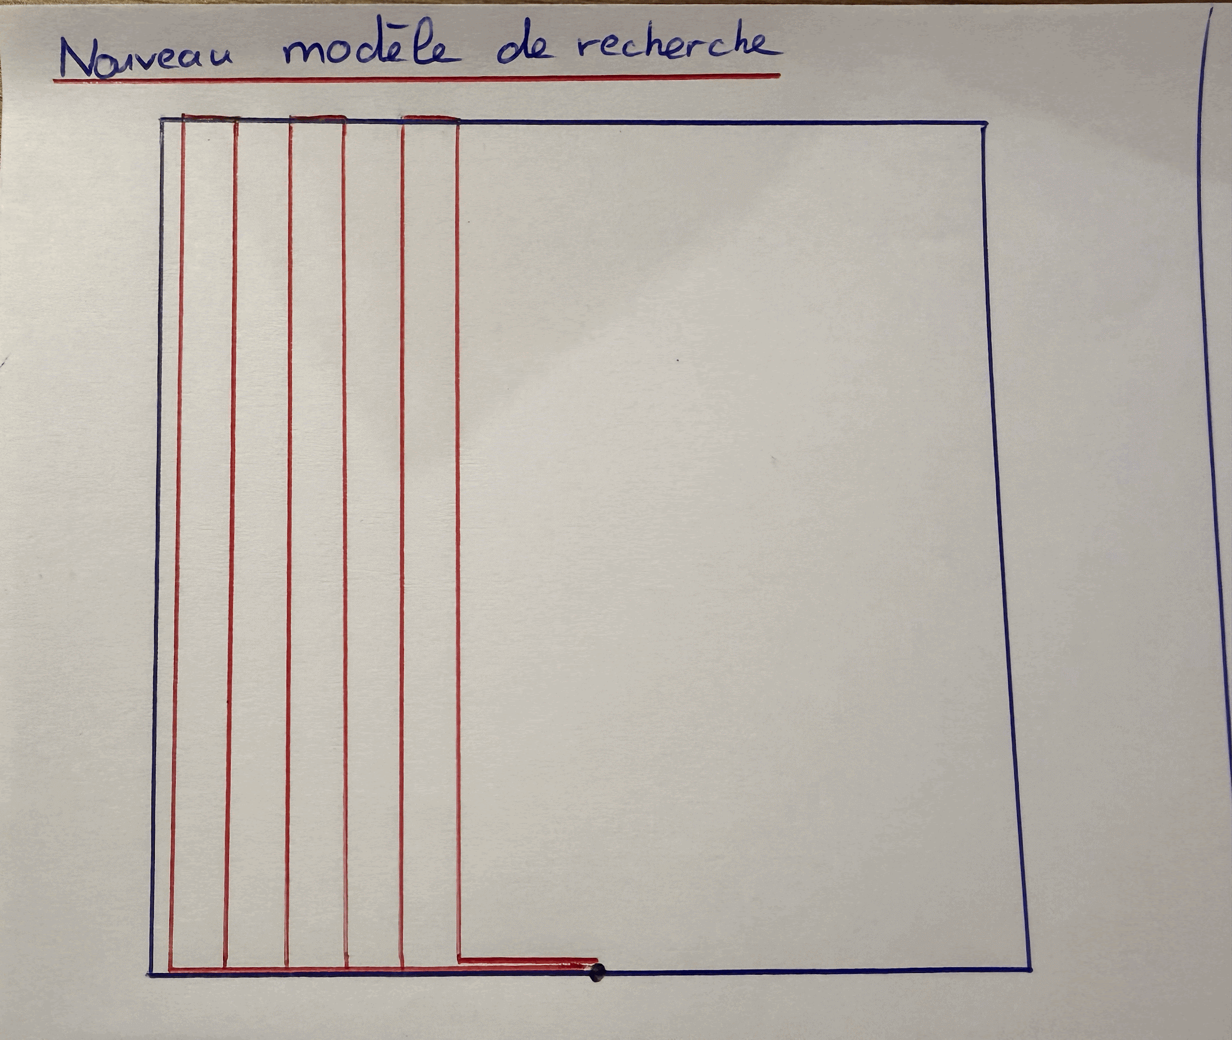
Search for individuals on a flat 1 km² plot

Slide 13
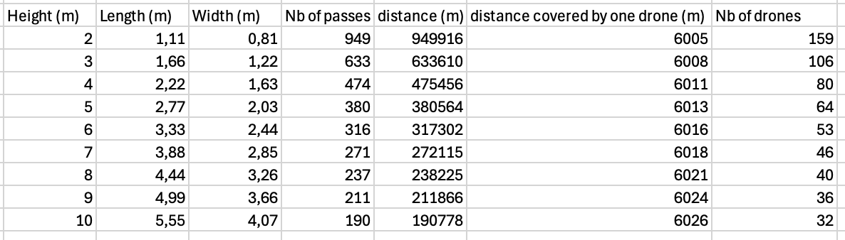
Search for individuals on a flat 1 km² plot
For H=10 : 22 min → 7,26 km

Slide 14
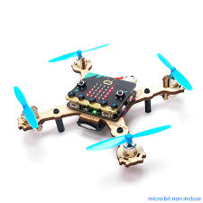
02
Drone
Conception

Slide 15
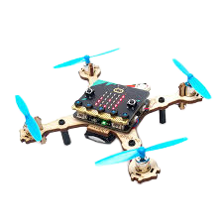

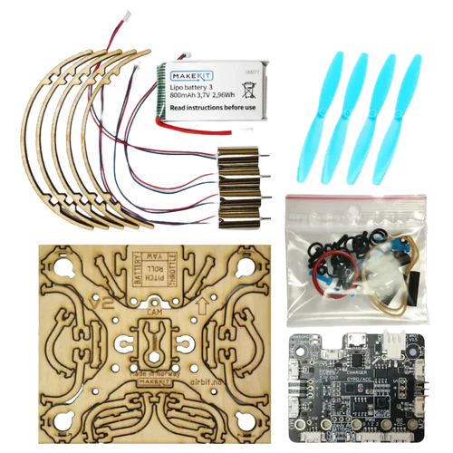
Drone Air bit 2
Specifications::
Flight time: 7–10 min
Speed: 20 km/h

Slide 16
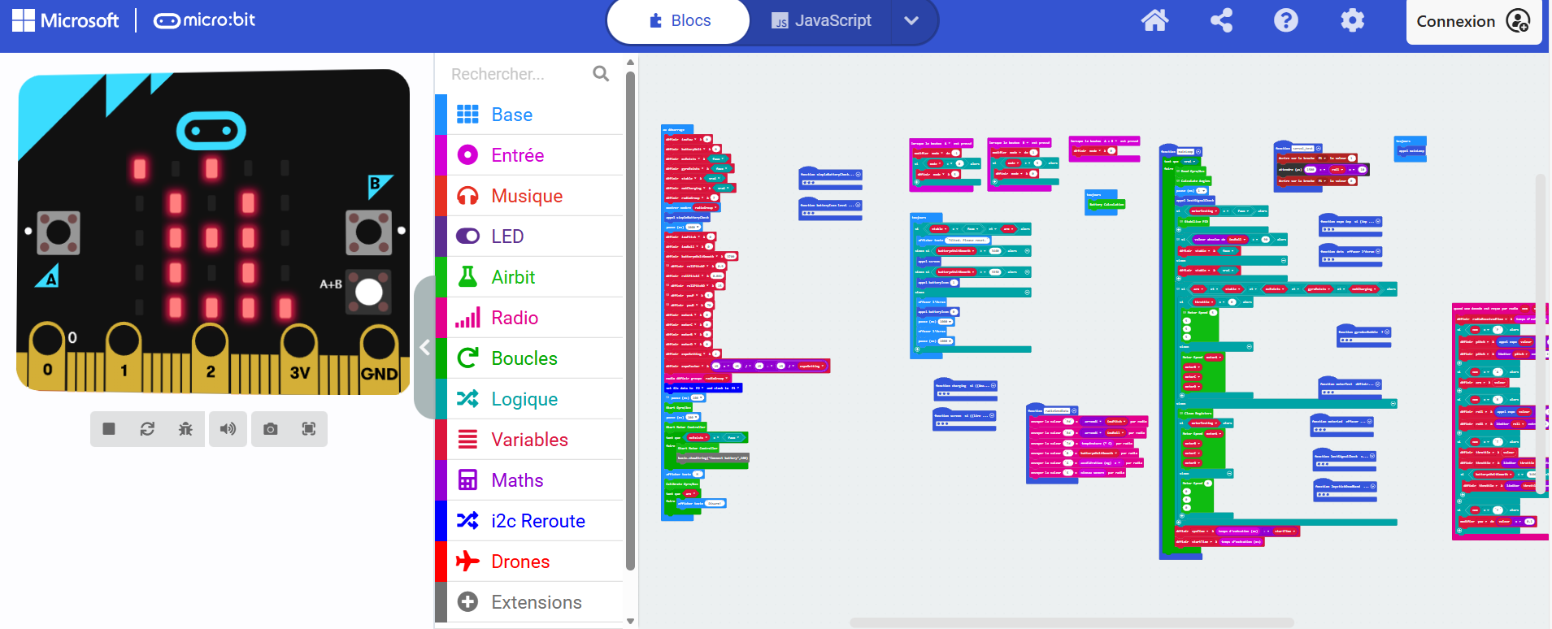
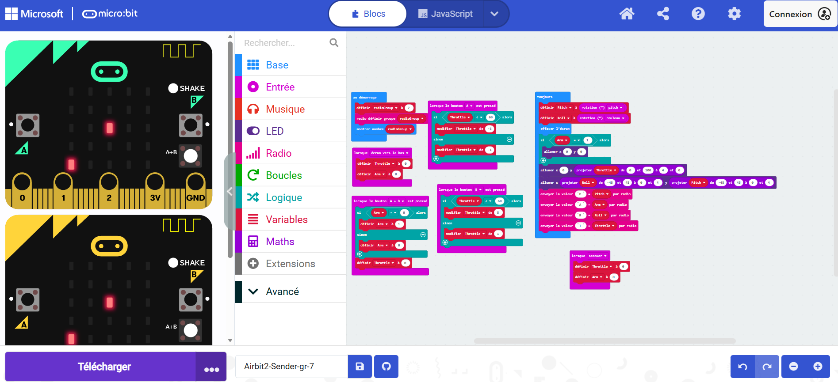
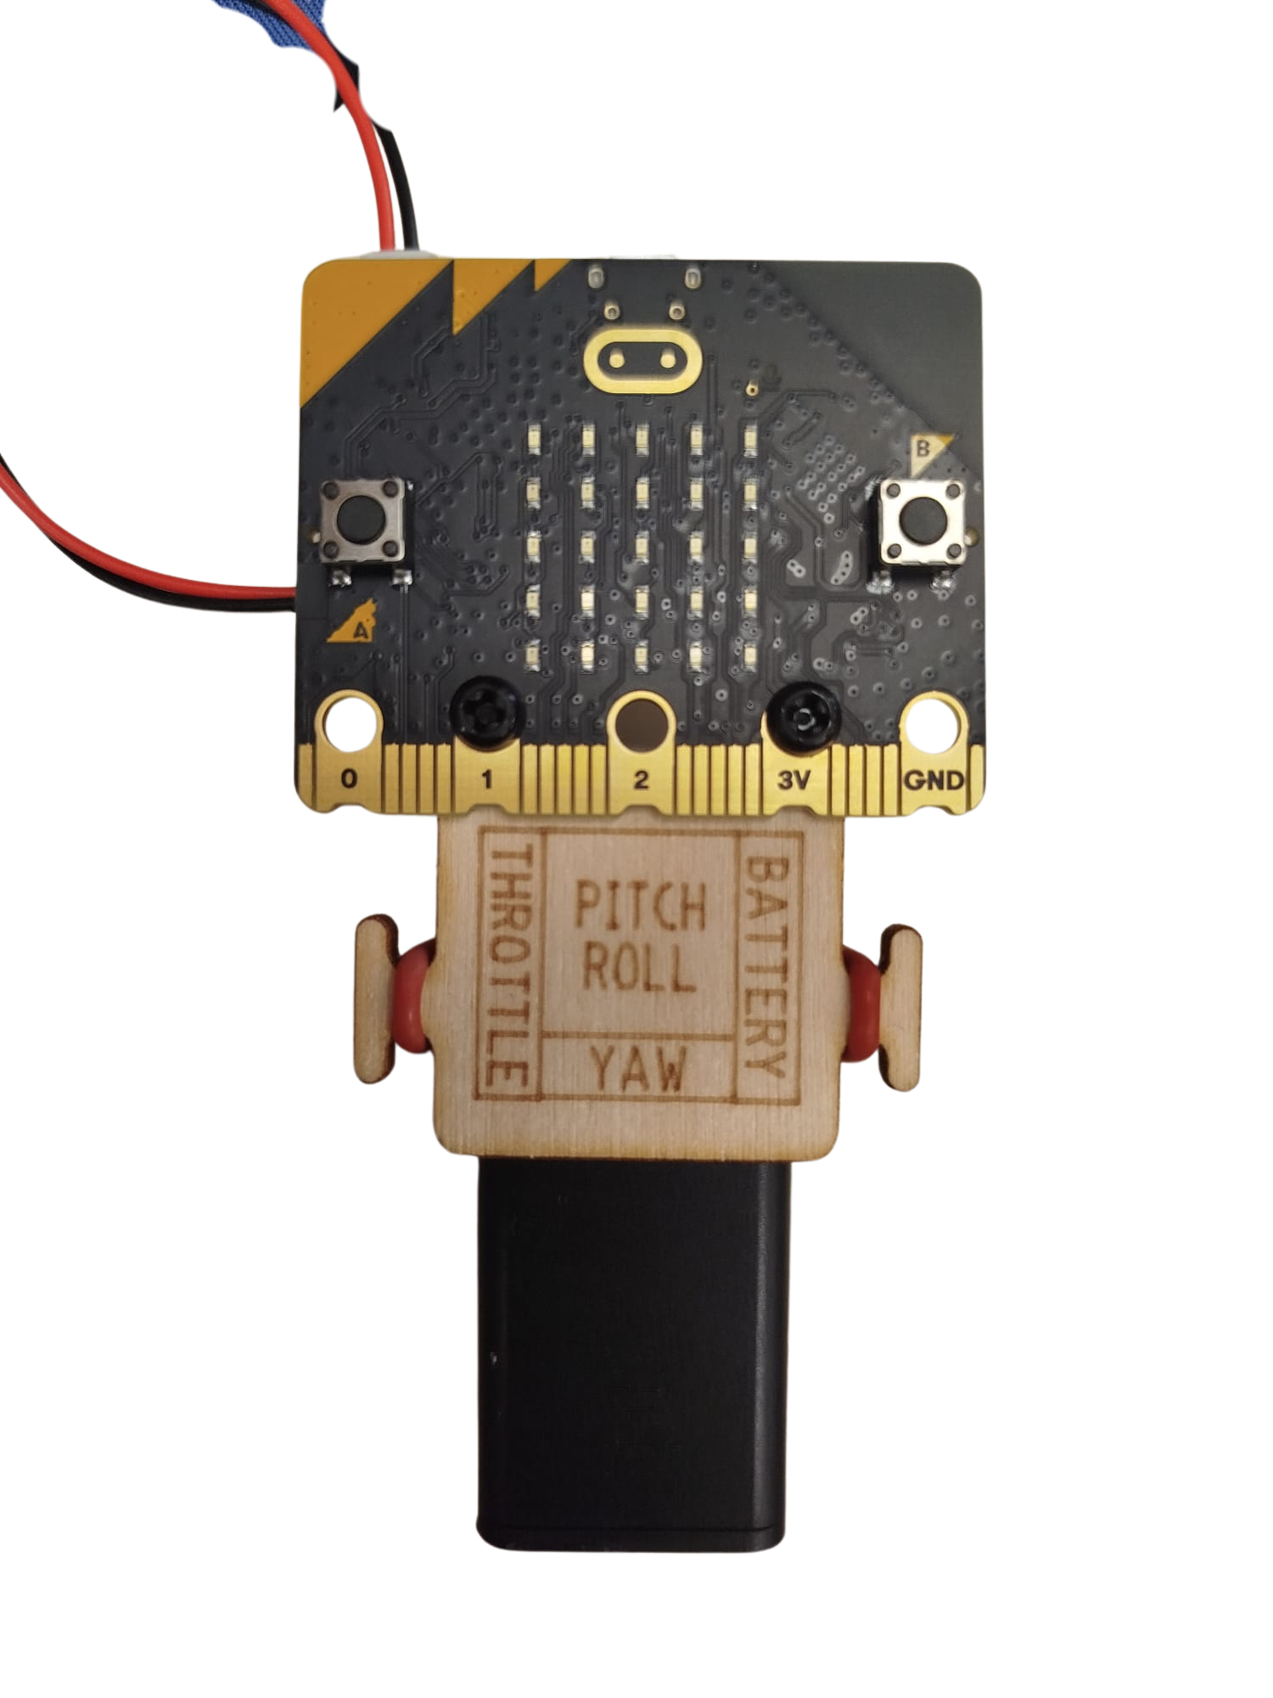

Drone Programming

Slide 17
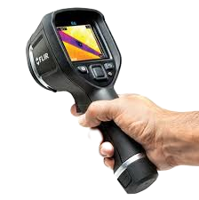
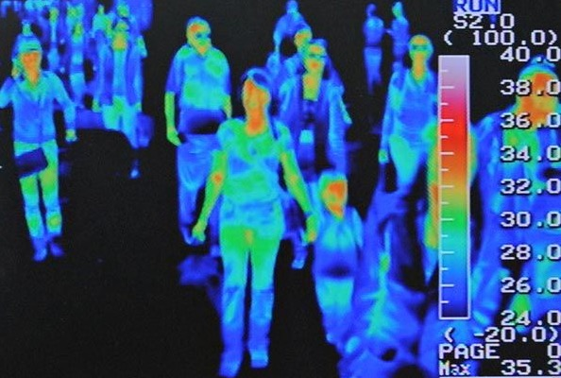
03
Thermal
Analysis

Slide 18
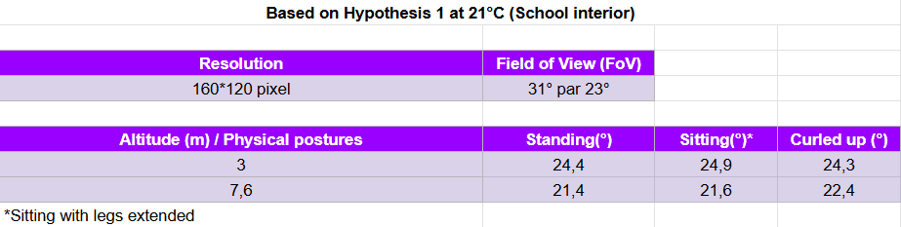
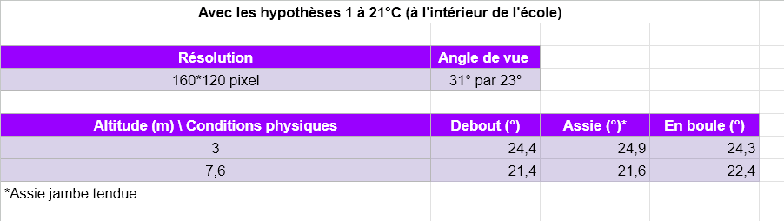
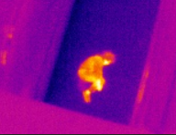
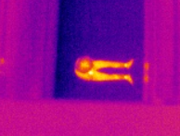
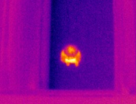
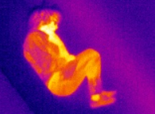
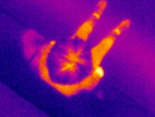
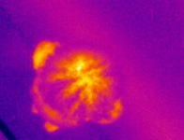
Thermal Analysis
Indoor testing,

Slide 19
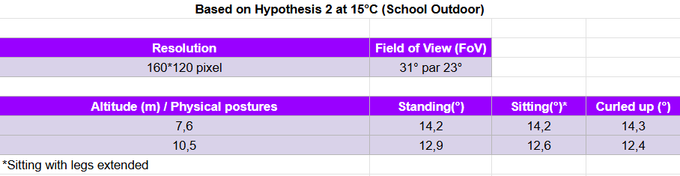
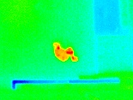
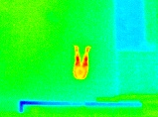
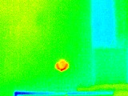
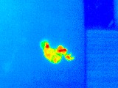
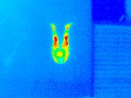
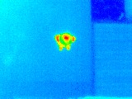
Thermal Analysis
Outdoor testing,

Slide 20
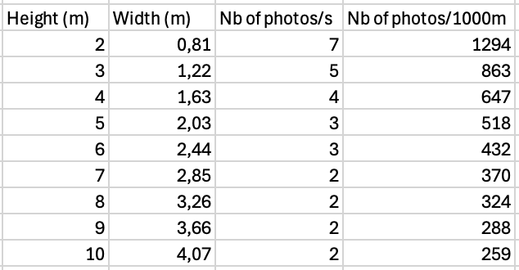
Thermal Analysis

Slide 21
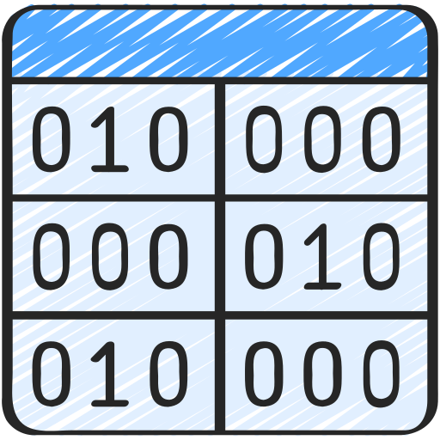
Thermal Analysis
From thermal input to data analysis

Slide 22
04
Image
Processing

Slide 23
Goal and development
Development logic
Establish simple hypotheses
Complicate them, step by step, to reflect the reality on the ground
Main goal :
detect the presence of a human being

Slide 24

Search with a normal camera
We must detect a singularity in the landscape

Slide 25




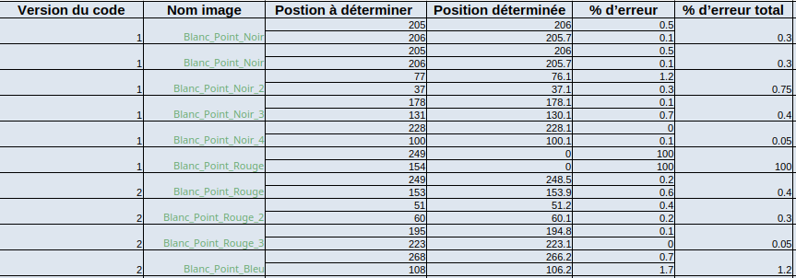
Code version 1
and version 2

Slide 26
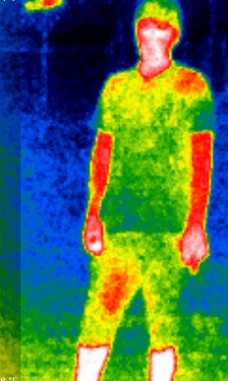
Search with a thermal camera
Why use a thermal imaging camera?
Climate difficulty
Night-time is a challenge

Slide 27
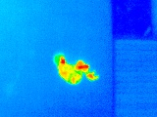
Goal and development
Paradigm :
Significant variation in the red spectrum (RGB) in the presence of a human being
Rest of the landscape : monochrome

Slide 28
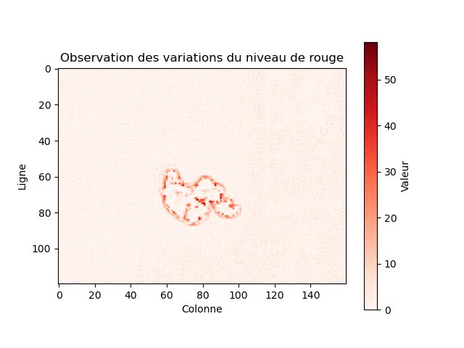

Thermal search code
Calcul de variations avec les 8 voisins
Calcul de variations avec les 4 voisins

Slide 29
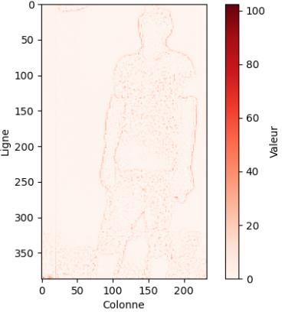
The outline of a human being

Slide 30
Conclusion
Increasingly precise research to define the detection zone and how to detect a person
Connecting drones to each other
Feedback to base
Further reducing the number of drones
Program adaptability in different environments
Determining the characteristics of a human being. ML for training a detection programme

Slide 31
Thank you for your attention.
Ilona BERTIN, Mélina BRUTIER, Louis OSCABY, Florent NASSCHAERT

